Slide 1


Welcome to the
Python DeCal!
Lecture: Astropy
[Class 17] November 3rd, 2025

Slide 2
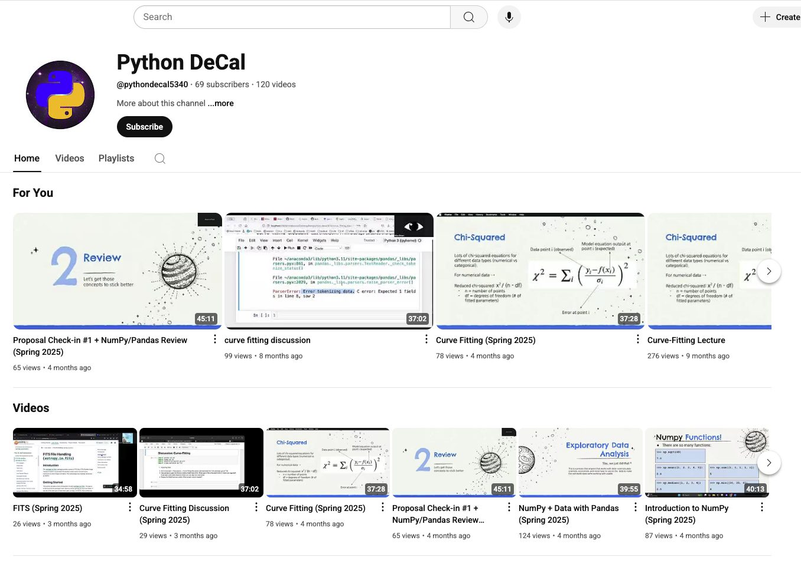
Lectures will be Recorded
This class will be recorded and posted to our YouTube Channel!
Subscribe :)

Slide 3
Overview for today!
Announcements
Warm-up
Demo
  Astropy
Lecture Engagement

Slide 4
01
Announcements
:) :) :) :) :) :) :) :) :) :) :) :)

Slide 5
Announcements
HW #9 is due this Wednesday, Nov. 5th at 11:59 PM
HW #10 was released today, Monday Nov. 3rd
HW #10 is due next Wednesday, Nov 12th at 11:59 PM

Slide 6
02
Warm-Up
Let’s do a little review

Slide 7
Warm-up questions
Please write your answers on a piece of paper:
How do you import curve_fit into a Jupyter Notebook?
What’s the difference between popt and pcov?
What does it mean to mask your data?
Why do you use initial guess (p0) in curve_fit?

Slide 8
Answers to Questions
from scipy.optimize import curve_fit
popt = best-fit parameters of your model,
pcov = covariance matrix (uncertainties)
mask = exclude certain data points
helps the curve_fit algorithm find a solution faster

Slide 9
03
Demo:
Astropy

Slide 10
Astropy

Slide 11
Practice Questions
With distance, velocity and time:
  Convert distance to AU
  Convert velocity to m/s
  Convert time to minutes
What happens if you add distance + velocity?
With: travel_time = (500 * u.km) / (100 * u.m / u.s)
  What are the units of travel time?
  Convert travel time to seconds and minutes

Slide 12
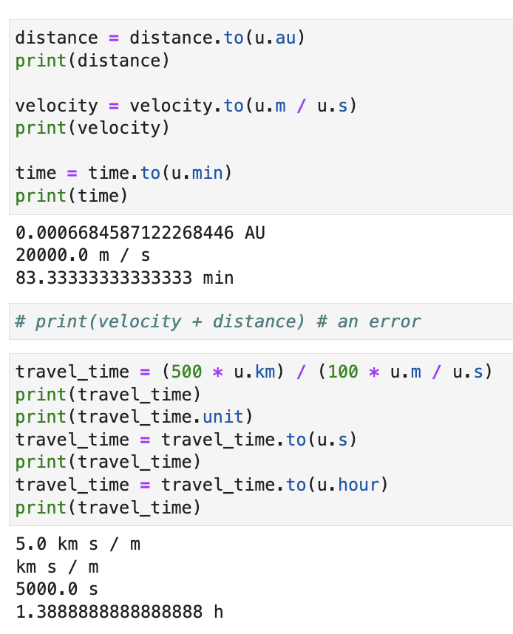
Answers to Questions

Slide 13
Practice Questions
Calculate the energy in joules for:
  5 kg
  1 gram
  1 solar mass (const.M_sun)
Calculate the escape velocity from Earth:
  v_esc = sqrt(2 * G * M / R)
  Mass of earth = const.M_earth
  G = const.G

Slide 14
04
Lecture Engagement
Show us what you know!

Slide 15
Lecture Engagement
Fill out the engagement assignment on Gradescope!
Always due before next class.
Takes 1-5 minutes to complete.

